Slide 1



Where: Organisation Units
Introduction to DHIS2

Slide 2


Introduction
“What”
“Where”
“When”
39
Notes:
In the previous video, you learned that any data value in DHIS2 has at least three dimensions associated with it: the “what”, the “where” and the “when”.

Slide 3
What is this video about?
“Where”
Organisation units
Notes:
In this video, we are going to talk about the “where” dimension: organisation units.

Slide 4
What is an organisation unit?
Organisation units
1. Location
2. Geographical context
Province or region
Health Facility
School
Notes:
What is an organisation unit?
In simple terms, organisation units represent the location or the larger geographical context of the data. Examples of organisation units include a health facility or school where services are provided or an administrative unit, representing a geographical area, such as province or a region.

Slide 5



Example of an organisational hierarchy
Lao PDR
2. Administrative Unit
Country
Level 1
Provinces
Level 2
Level 3
Districts
Facilities
Level 4
Notes:
For example in Lao, a country whose Ministry of Health uses DHIS2, the highest level, or the root organisation unit, is the country. The country is further divided into 18 provinces, and each of those is subdivided into smaller districts. At the lowest level, you will find individual health facilities where the data are collected.
Together, all of the organisation units form a hierarchical tree. In Lao’s case, the hierarchy has 4 levels which correspond to its administrative system.
The structure of the hierarchy, including the number of levels, is fully customisable in DHIS2 to adapt to each country's context.

Slide 6
Why is hierarchy important?
Aggregate
Disaggregate
Notes:
Organisation units determine where data can be captured and how they can be aggregated or disaggregated within various reporting outputs.

Slide 7
Aggregation of data using the organisational hierarchy
22
Province
5
District
17
District
2
2
1
2
5
10
Facilities
Notes:
For example, all data entered at the facility level could be aggregated to provide a total value for the entire district. This principle is the same as you move up the hierarchy. During the aggregation process, data are added up from the lower organisation unit levels to the higher ones. DHIS2 performs these calculations automatically.

Slide 8
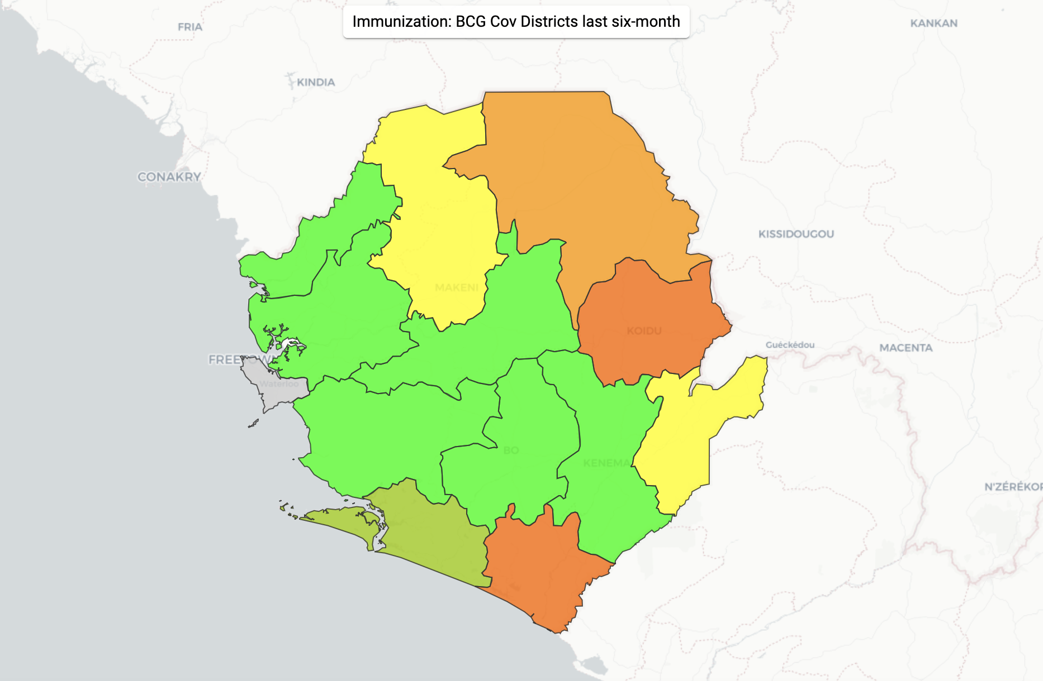
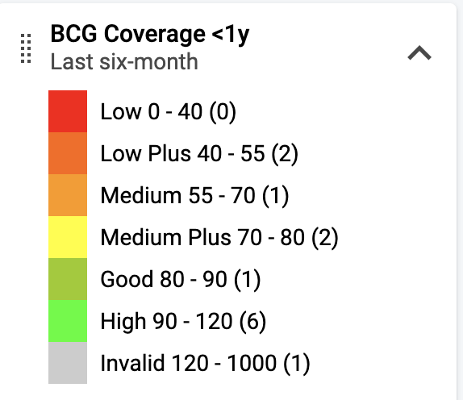
Organisation units can be mapped
Notes:
organisation units also allow you to display your data in the DHIS2 Maps application and highlight your data geographically.

Slide 9
Classifying organisation units
Organisation unit groups
Country
Organisation unit group set
Provinces
Districts
Facilities
Notes:
DHIS2 also allows classifying organisation Units by different criteria than the main administrative hierarchy.
We can do this by using “organisation unit groups” and “organisation unit group sets”. An organisation unit group allows for additional sub-classifications of organisation units.

Slide 10
Country
Provinces
Districts
Facilities
Example of a 4-level organisation unit hierarchy
Notes:
DHIS2 also allows classifying organisation Units by different criteria than the main administrative hierarchy.
We can do this by using “organisation unit groups” and “organisation unit group sets”. An organisation unit group allows for additional sub-classifications of organisation units.

Slide 11
Classifying organisation units
Type
organisation Unit Group Sets
Organisation unit groups
Country
Provinces
District hospital
Districts
Facilities
Field clinic
Notes:
For example, we can create a parallel classification of health facilities, grouping them by type such as District hospital or field clinic;

Slide 12
Classifying organisation units
Type
organisation Unit Group Sets
Organisation unit groups
Country
organisation Unit Groups
Provinces
Private
Districts
Facilities
Public
Notes:
by the form of ownership such as public or private

Slide 13
Classifying organisation units
Type
organisation Unit Group Sets
Organisation unit groups
Country
organisation Unit Groups
Provinces
Urban
Districts
Facilities
Rural
Notes:
or by location such as urban or rural. This is defined for each specific context and will be different from country to country.

Slide 14
Example of organisation unit groups and group set
Organisation unit group set
Type of facility
Organisation unit groups
Dispensary
Health
Center
Specialist Hospital
Referral Hospital
Notes:
Let's have a look at an example of classification by the type of facility.
In this example, health facilities are classified and clustered by the range of services they provide, into various organisation unit groups. These groups include Dispensary, Health Center, Specialist Hospital, and Referral Hospital.
The organisation unit “Group set” is the name for the umbrella classification that these individual groups fall under, in this example, the group set is “Type of facility”, a category that contains the organisation unit groups, which in turn each contain specific facilities

Slide 15
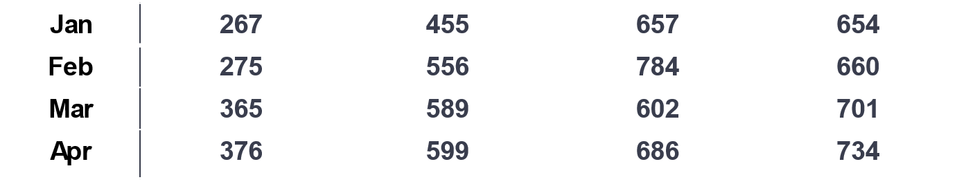
Data disaggregation by groups
Malaria positive tests
Dispensary
Health Center
Specialist Hospital
Referral Hospital
Notes:
Organisation unit groups and group sets are quite useful for disaggregating data in our analysis. In this example, we disaggregated data for malaria positive tests by the type of facility to see the trend for each group separately and to compare monthly data from each type of facility, making it easier to uncover potential variations between them.

Slide 16
Summary
Organisation units provide geographical context to data
Hierarchy = administrative system of a country or region
Hierarchy enables data aggregation
Organisation units can be also classified by
Groups
Group sets
Notes:
In summary, Organisation units provide geographical context to data. In DHIS2, organisation units are hierarchically related to each other, with each level reflecting the administrative system of the country or region. The Organisation unit hierarchy also enables data aggregation. Data that are collected at the facility levels are aggregated upward to higher-level administrative units like districts or regions. DHIS2 also allows classifying organisation Units by different criteria, such as facility type, by using Organisation Unit Groups and Group sets to facilitate more nuanced data analysis.

